Slide 1


“Advanced C Programming”

Slide 2
Day 1
Introduction to Linux, vi editor and C
Data Types in C & Operators in C

Slide 3
2. (a) Data types

Slide 4
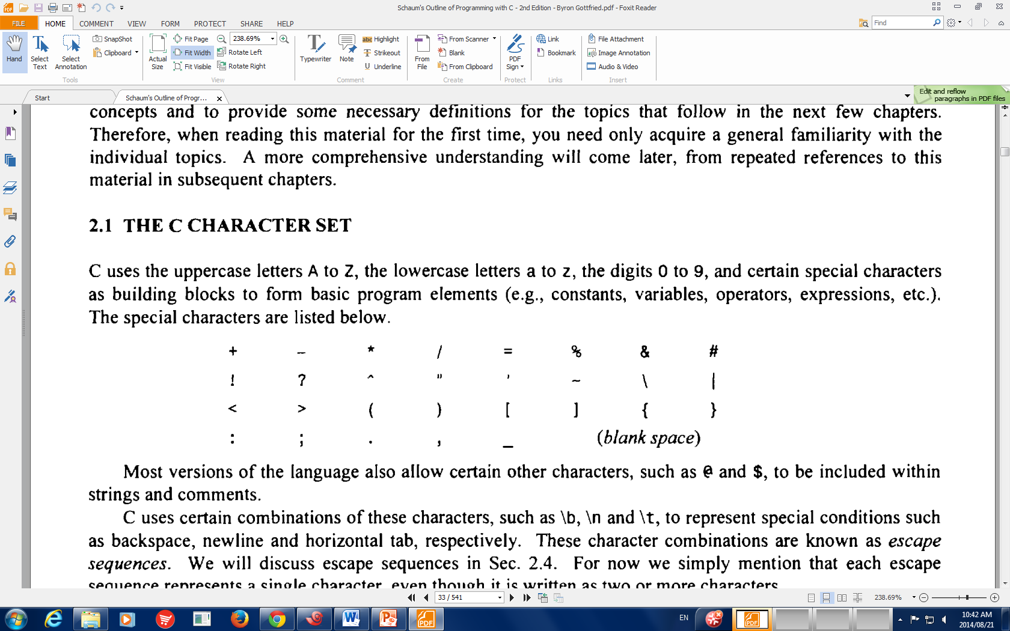
C Language Character Set
C is a language, hence it requires characters to build its building blocks.
Every character has its own ASCII Value
C character Set contains:
The uppercase letters A to Z
The lowercase letters a to z
The digits 0 to 9
Certain special characters

Slide 5
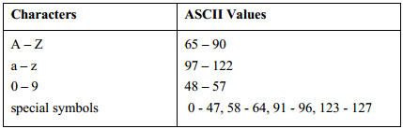
Character Set – ASCII Values
ASCII - American Standard Code for Information Interchange
Total – 128 Characters
Printable Characters – 95
Non-printable Control characters - 33

Slide 6
Basics
Tokens: Individual unit of C program is called as Tokens
Keywords , Identifiers, Operators, Special Symbols, Constants, Strings, Data values
Variable declarations: int i; ﬂoat f;
Initialization: char c=’A’; int y=10;
Operators: +,−,∗,/,% and many more….
Expressions: int x,y,z; x=y∗2+z∗3;
Functions: int factorial (int n); /∗function takes int , returns int ∗/

Slide 7
Variables
A variable is a name for a location in memory
A variable must be declared by specifying the variable's name and the type of information that it will hold
Variable should be declared before we use it
data type
variable name
int total;
int count, temp, result;
Multiple variables can be created in one declaration

Slide 8
Variable Initialization
A variable can be given an initial value in the declaration
int sum = 0;
int base = 32, max = 149;
When a variable is referenced in a program, its current value is used

Slide 9
Variable Assignment
An assignment statement changes the value of a variable
The assignment operator is the = sign
total = 55;
The expression on the right is evaluated and the result is stored in the variable on the left
The value that was in total is overwritten
You can only assign a value to a variable that is consistent with the variable's declared type

Slide 10
Assignment Through a Function
y = f(x);
Q = sin(30);
The assignment operator is still the = sign

Slide 11
Assignment Through scanf()
int variable;
scanf(“%d”, &variable);
<keyboardinput> 30
There is not assignment operator in this case

Slide 12
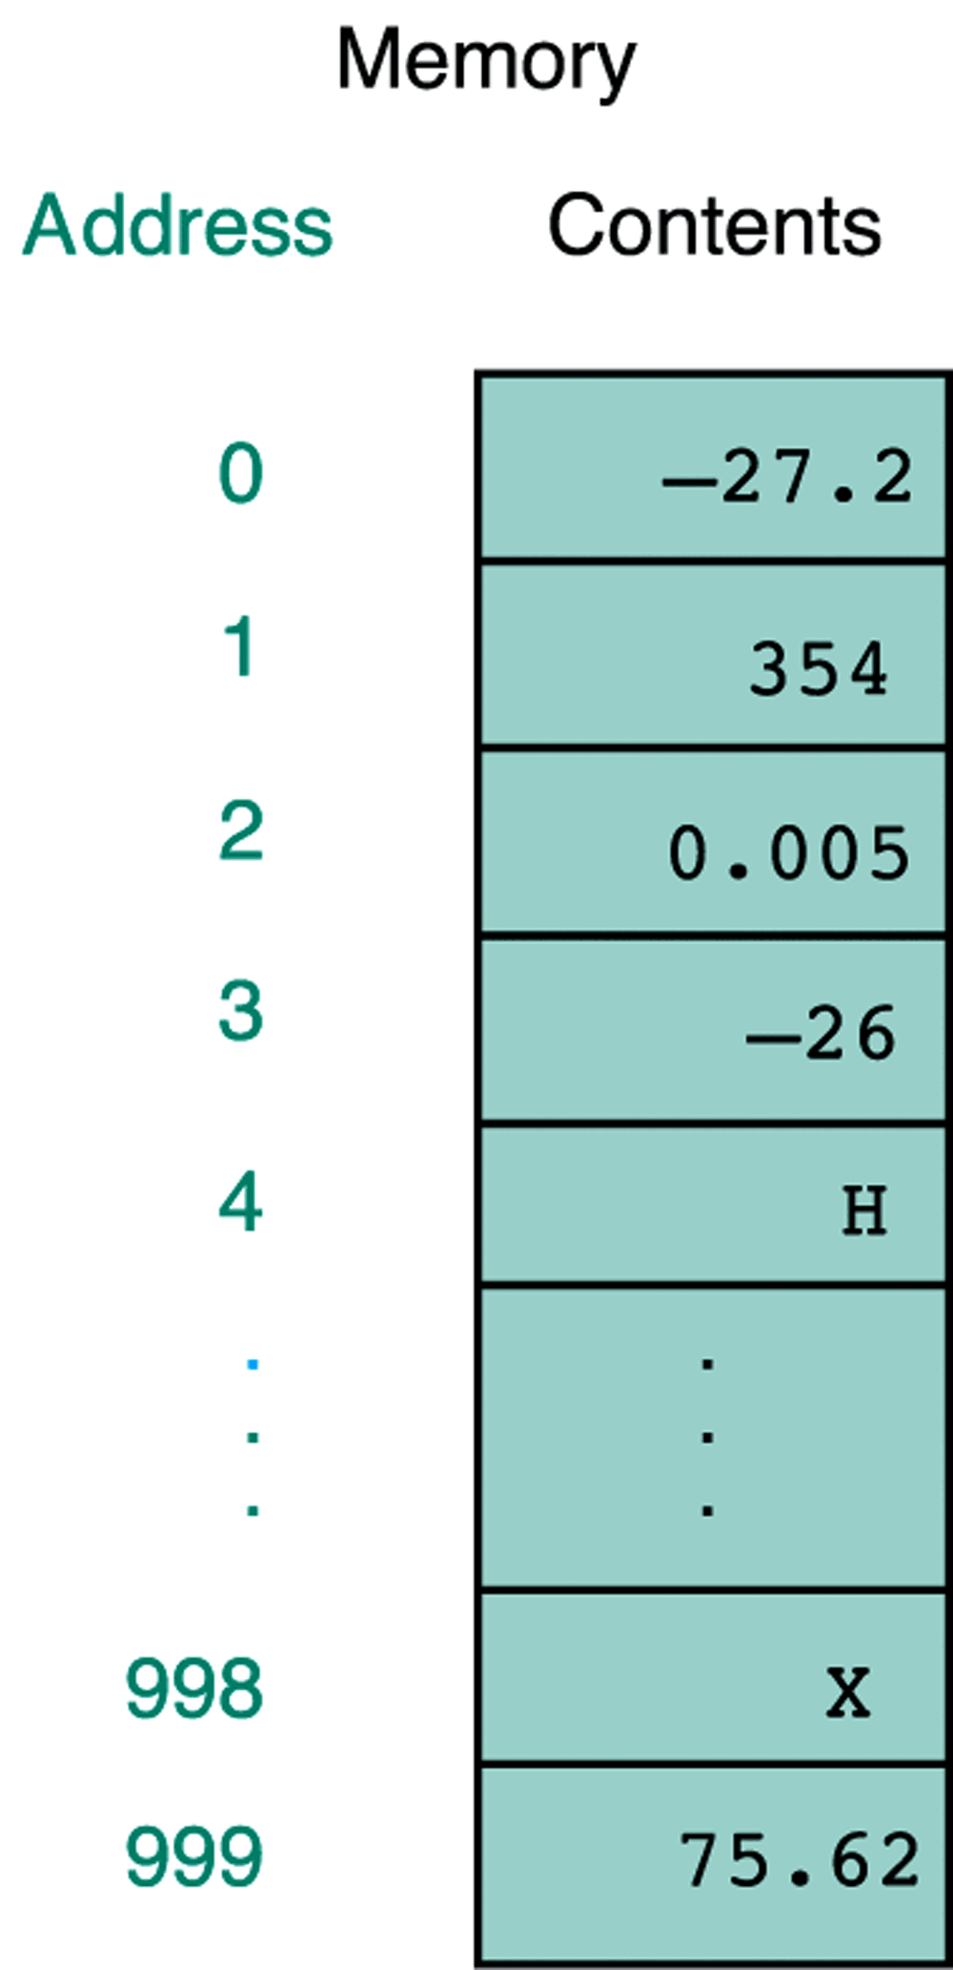
Variables in Memory

Slide 13
Binary Numbers
Once information is digitized, it is represented and stored in memory using the binary number system
A single binary digit (0 or 1) is called a bit
Devices that store and move information are cheaper and more reliable if they have to represent only two states
A single bit can represent two possible states, like a light bulb that is either on (1) or off (0)
Permutations of bits are used to store values

Slide 14
Bit Permutations
1 bit
2 bits
3 bits
4 bits
0
1
00
01
10
11
000
001
010
011
100
101
110
111
0000
0001
0010
0011
0100
0101
0110
0111
1000
1001
1010
1011
1100
1101
1110
1111
Each additional bit doubles the number of possible permutations

Slide 15
Bit Permutations
Each permutation can represent a particular item
There are 2^{N} permutations of N bits
Therefore, N bits are needed to represent 2N unique items
1 bit ?
2 bits ?
3 bits ?
4 bits ?
5 bits ?
2¹ = 2 items
How many
items can be
represented by
2² = 4 items
2³ = 8 items
2⁴ = 16 items
2⁵ = 32 items

Slide 16
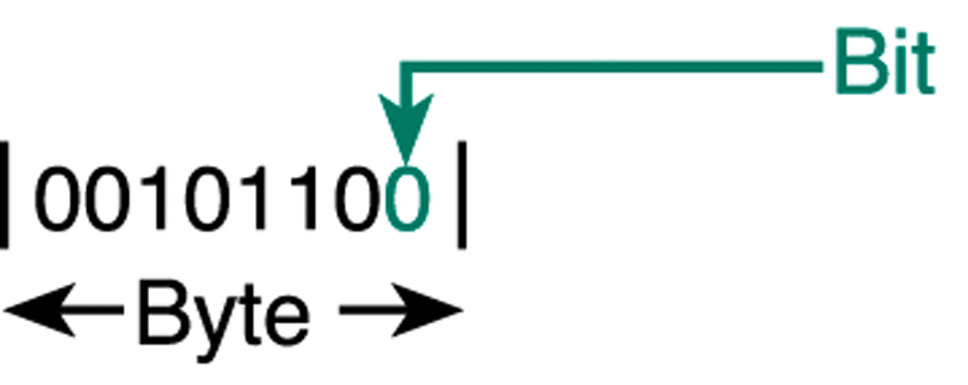
Relationship Between a Byte and a Bit

Slide 17
What is the value of this binary number?
0 0 1 0 1 1 0 0
0 0 1 0 1 1 0 0
0*2⁷ + 0*2⁶ + 1*2⁵ + 0*2⁴ + 1*2³ + 1*2² + 0*2¹ + 0*2⁰
0*128 + 0*64 + 1*32 + 0*16 + 1*8 + 1*4 + 0*2 + 0*1
0*128 + 0*64 + 1*32 + 0*16 + 1*8 + 1*4 + 0*2 + 0*1
32+ 8 + 4 = 44 (in decimal)

Slide 18
What is the maximum number that can be stored in one byte (8 bits)?

Slide 19
What is the max.num. that can be stored in one byte (8 bits)?
1 1 1 1 1 1 1 1
1 1 1 1 1 1 1 1
1*2⁷ + 1*2⁶ + 1*2⁵ + 1*2⁴ + 1*2³ + 1*2² + 1*2¹ + 1*2⁰
1*128 + 1*64 + 1*32 + 1*16 + 1*8 + 1*4 + 1*2 + 1*1
128 + 64 + 32 + 16 + 8 + 4 + 2 + 1 = 255 (in decimal)
Another way is: 1*2⁸ – 1 = 256 – 1 = 255

Slide 20
What would happen if we try to add 1 to the largest number that can be stored in one byte (8 bits)?
1 1 1 1 1 1 1 1
+
1
-------------------------------
1 0 0 0 0 0 0 0 0
0 0 0 0 0 0 0 0

Slide 21
Variables…
Variable Naming Rules:
Variable names can contain letters, digits and _;
First character must be a letter
Variable names should start with letters.
Keywords (e.g., for, while, do, if, switch etc.) cannot be used as variable names and are reserved
Variable names are case sensitive.
Example: int x, X; → x and X are two different variables

Slide 22
Variable Definition & Declaration
Variable Definition: A variable definition means to tell the compiler where and how much to create the storage for the variable.
Examples:
int i, j, k;
char ch;
Variable Declaration: A variable declaration provides assurance to the compiler that there is one variable existing with the given type and name so that compiler proceed for further compilation without needing complete detail about the variable.
Example:
extern int dssd; ← Declaration
int main()
{
int dssd; ← Definition
}

Slide 23
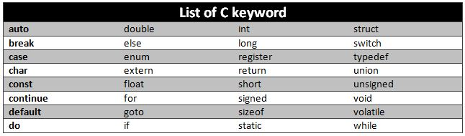
Keywords in C
Total keywords - 32
Additional C99 key words (Total -5):
inline – For writing inline functions (Discuss in functions)
_imaginary – To declare imaginary values (iy)
_complex – To declare complex variables (a+ib)
_Bool – To declare a Boolean type variable (stdbool.h)
restrict – To declare restricted pointers

Slide 24
Quiz
int money$owed;
int total_count;
int score2 ;
int 2ndscore;
int long;
_Bool x;
Incorrect
Correct
Correct
Incorrect
Incorrect
Correct (B must be capital letter or “bool”)

Slide 25
Data Types
Data type of an object determines:
Type of values it can have
Type of operations that can be performed on it
Data Types:
Basic data types → int, char, float, double
Enumerated data types → enum
Void data type → void
Derived data types → Arrays, Pointers, Structures and Unions

Slide 26
Sizes of Basic data types
Type | Size | Value Range
char | 1 | -128 to 127
unsigned char | 1 | 0 to 255
signed char | 1 | -128 to 127
int | 2 or 4 | -32,768 to 32,767 (or) -2,147,483,648 to 2,147,483,647
unsigned int | 2 or 4 | 0 to 65,535 (or) 0 to 4,294,967,295
Short | 2 | -32,768 to 32,767
unsigned short | 2 | 0 to 65,535
long | 4 | -2,147,483,648 to 2,147,483,647
unsigned long | 4 | 0 to 4,294,967,295

Slide 27
Computer Memory
9278
9279
9280
9281
9282
9283
9284
9285
9286
Main memory is divided into many memory locations (or cells)
Each memory cell has a numeric address, which uniquely identifies it

Slide 28
Storing Information
9278
9279
9280
9281
9282
9283
9284
9285
9286
Each memory cell stores a set number of bits (usually 8 bits, or one byte)
10011010
Large values are
stored in consecutive
memory locations

Slide 29
Storing a char
9278
9279
9280
9281
9282
9283
9284
9285
9286
char (8 bits = 1 byte)

Slide 30
Storing a short
9278
9279
9280
9281
9282
9283
9284
9285
9286
short (16 bits = 2 bytes)

Slide 31
Storing an int
9278
9279
9280
9281
9282
9283
9284
9285
9286
int (32 bits = 4 bytes)

Slide 32
Storing a long
long (64 bits = 8 bytes)
9278
9279
9280
9281
9282
9283
9284
9285
9286

Slide 33
Storing a float
9278
9279
9280
9281
9282
9283
9284
9285
9286
float (32 bits = 4 bytes)

Slide 34
Storing a double
double (64 bits = 8 bytes)
9278
9279
9280
9281
9282
9283
9284
9285
9286

Slide 35
The sizeof() operator
#include <stdio.h>
#include <stdlib.h>
int main()
{
printf("Size of char = %d \n", sizeof(char));
printf("Size of short = %d \n", sizeof(short));
printf("Size of int = %d \n", sizeof(int));
printf("Size of long = %d \n", sizeof(long));
printf("Size of long long = %d \n", sizeof(long long));
printf("Size of float = %d \n", sizeof(float));
printf("Size of double = %d \n", sizeof(double));
printf("Size of long double = %d \n", sizeof(long double));
return 0;
}

Slide 36
Void Data Type
The type specifier void indicates that no value is available.
It is an empty data type
It can be used in the following situations
Function returns as void A function with no return value has the return type as void.
Example: void exit (int status);
Function arguments as void A function with no parameter can accept as a void.
Example: int rand(void);
Pointers to void A pointer of type “void *” represents the address of an object, but not its type. For example a memory allocation function
Example: void *malloc( size_t size );
It returns a pointer to void which can be casted to any data type.

Slide 37
Type Conversions
Type conversion: It is a way to convert a variable/constant from one data type to another data type. There are two types:
Implicit type conversion
Explicit Type conversion
a) Implicit type conversion: Implicit type conversion, also known as coercion, is an automatic type conversion by the compiler.
#include <stdio.h>
main()
{
int i = 10;
char c = ‘a'; /* ascii value is 97 */
float sum;
sum = i + c;
printf("Value of sum : %f\n", sum );
}
Output: 107.0

Slide 38
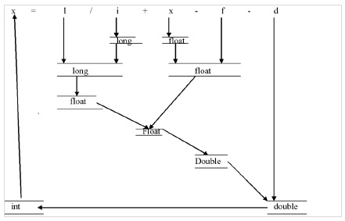
Type Conversions
int i,x;
float f;
double d;
long int l;
Source: https://www.tutorialspoint.com/what-are-implicit-and-explicit-type-conversions-in-c-language

Slide 39
Type Conversions
#include<stdio.h>
void main()
{
int i=65;
printf("%c\n", i);
printf("%c\n", i+1);
}
Source: https://www.tutorialspoint.com/what-are-implicit-and-explicit-type-conversions-in-c-language

Slide 40
Type Conversions
b) Explicit type conversion: Converting the data type of a variable/operand/expression from one data type to another data type explicitly by the programmer using type cast operator.
Syntax:
(type_name) expression
#include <stdio.h>
main()
{
int sum = 14, count = 4;
double mean;
mean = (double) sum / count;
printf("Value of mean : %f\n", mean );
}
Output: 3.5

Slide 41
Type Modifiers
The modifiers define the amount of storage allocated to the variable.
short
long
signed
unsigned
Rule:
short int <= int <= long int float <= double <= long double
Syntax:
short int x;
long int x;
unsigned int x;
unsigned long int x

Slide 42
Type Modifiers…
int main()
{
printf("sizeof(char) == %d\n", sizeof(char));
printf("sizeof(short) == %d\n", sizeof(short));
printf("sizeof(int) == %d\n", sizeof(int));
printf("sizeof(long) == %d\n", sizeof(long));
printf("sizeof(float) == %d\n", sizeof(float));
printf("sizeof(double) == %d\n", sizeof(double));
printf("sizeof(long double) == %d\n", sizeof(long double));
printf("sizeof(long long) == %d\n", sizeof(long long));
return 0;
}
Output: Machine dependent (1, 2, 4, 8, 4, 8, 16, 8)

Slide 43
Escape Sequences
Combination of characters comprising of backslash followed by a character
backslash causes an "escape" from the normal way characters are interpreted by the compiler
\a Alarm or Beep
\b Backspace
\f Form Feed
\n New Line
\r Carriage Return
\t Tab (Horizontal)
\v Vertical Tab
\\ Backslash
\‘ Single Quote
\“ Double Quote
\? Question Mark

Slide 44
Escape Sequences
Combination of characters comprising of backslash followed by a character
backslash causes an "escape" from the normal way characters are interpreted by the compiler
\a Alarm or Beep
\b Backspace
\f Form Feed
\n New Line
\r Carriage Return
\t Tab (Horizontal)
\v Vertical Tab
\\ Backslash
\‘ Single Quote
\“ Double Quote
\? Question Mark

Slide 45
Escape Sequences
#include<stdio.h>
int main(){
printf("C language\n");
printf("\nC\nC++\n");
printf("\'java\' \n");
printf("\"Python\" \n");
printf("\"Do you know C language \? \" \n");
printf("C\t C++ \n");
printf("C\vC++ \n");
return 0;
}

Slide 46
2. (b) Operators

Slide 47
Operators, operands and expressions
Operators are symbols which take one or more operands or expressions and perform arithmetic or logical computations.
Examples: +, -, *, /, =, ==
An "operand" is an entity on which an operator acts.
Example: a+b-5 → a, b and 5 are operands
An "expression" is a sequence of operators and operands that performs any combination of these actions:
Computes a value
Designates an object or function
Generates side effects
Example: a + (b / 6.0)

Slide 48
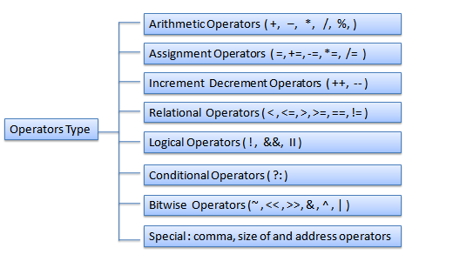
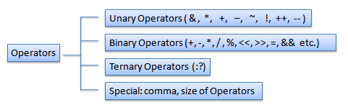
Types of Operators
Operators are classified in two ways
1. Based on Type of Operation
2. Based on number of operands

Slide 49
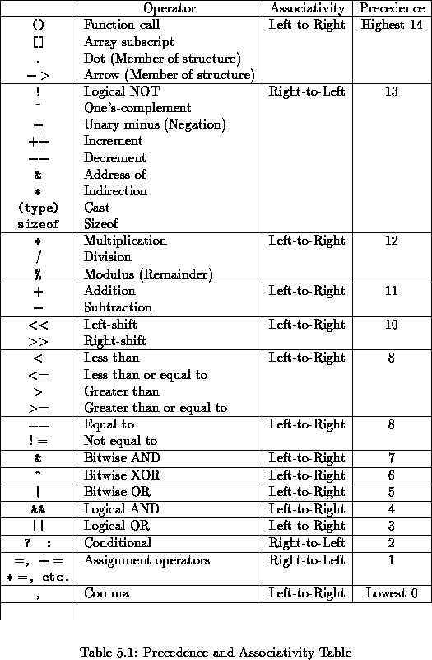
Precedence and Order of Evaluation

Slide 50
Conditional Operator
Syntax : ( Condition? true_value: false_value );
#include<stdio.h>
int main()
{
int n=6;
(n%2)?printf("Odd\n"):printf("Even\n");
return 0;
}

Slide 51
Quiz
What do you mean by Binary Operators?
What is an unary operator?
If x=10 and y=2, z=5 what is the value of x + y*z ?

Slide 52
Bitwise Operations
What is Memory?
Collection of Bits
In real life applications, some times it is necessary to deal with memory bit by bit
For example,
Gaming and Puzzles (Ex: Sudoku)
Controlling attached devices (Ex: Printers)
Obtaining status
Checking buffer overflows…
Note: The combination of bit level operators and the pointers can replace the assembly code. For example, only 10% of UNIX is written using assembly code and the rest is in C.
Notes:
52
See §2.9 and §6.9 in Kernighan & Ritchie

Slide 53
Bitwise Operations in Integers
There are six operators
& – AND
Result is 1 if both operand bits are 1
| – OR
Result is 1 if either operand bit is 1
^ – Exclusive OR
Result is 1 if operand bits are different
~ – Complement
Each bit is reversed
<< – Shift left
Multiply by 2
>> – Shift right
Divide by 2
Restrictions: We can use these operators only on int and char data typed variables - Signed and unsigned char, short, int, long, long long
Notes:
53
http://www.cs.umd.edu/class/spring2003/cmsc311/Notes/BitOp/bitwise.html

Slide 54
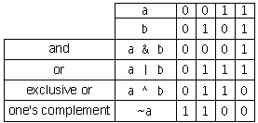
Bitwise Operations in Integers…
Notes:
54
http://www.cs.umd.edu/class/spring2003/cmsc311/Notes/BitOp/bitwise.html

Slide 55
Examples - &, |, ^ and ~
unsigned short int a,b;
unsigned short int c;
a = 0xb786
1 | 0 | 1 | 1 | 0 | 1 | 1 | 1 | 1 | 0 | 0 | 0 | 0 | 1 | 1 | 0
b = 0xb420
1 | 0 | 1 | 1 | 0 | 1 | 0 | 0 | 0 | 0 | 1 | 0 | 0 | 0 | 0 | 0
c = a&b = 0xb400
1 | 0 | 1 | 1 | 0 | 1 | 0 | 0 | 0 | 0 | 0 | 0 | 0 | 0 | 0 | 0
c = a|b = 0xb765
1 | 0 | 1 | 1 | 0 | 1 | 1 | 1 | 1 | 0 | 1 | 0 | 0 | 1 | 1 | 0
c = a^b = 0x0365
0 | 0 | 0 | 0 | 0 | 0 | 1 | 1 | 1 | 0 | 1 | 0 | 0 | 1 | 1 | 0
c = ~a = 0x4879
0 | 1 | 0 | 0 | 1 | 0 | 0 | 0 | 0 | 1 | 1 | 1 | 1 | 0 | 0 | 1
Notes:
55

Slide 56
Example - Left Shift (<<)
unsigned short int a = 0xb786;
A << = 3;
Before shift
a= 0xb786
1 | 0 | 1 | 1 | 0 | 1 | 1 | 1 | 1 | 0 | 0 | 0 | 0 | 1 | 1 | 0
After shift
a= 0x9a30
1 | 0 | 1 | 1 | 1 | 1 | 0 | 0 | 0 | 0 | 1 | 1 | 0 | 0 | 0 | 0
Last three bits are
filled with zeroes
Notes:
56

Slide 57
Example - Right Shift (<<)
unsigned short int a = 0xb786;
A << = 3;
Before shift
a= 0xb786
1 | 0 | 1 | 1 | 0 | 1 | 1 | 1 | 1 | 0 | 0 | 0 | 0 | 1 | 1 | 0
After shift
a= 0x16f0
0 | 0 | 0 | 1 | 0 | 1 | 1 | 0 | 1 | 1 | 1 | 1 | 0 | 0 | 0 | 0
First three bits are
filled with zeroes
Notes:
57

Slide 58
Quiz 1
What is the output of this code?
#include <stdio.h>
int main()
{
int x = 1, y = 0, z = 5;
int a = x && y || z++;
printf("%d \n", a); return 0;
}
Syntax Error
6
1
5
Answers: C (z++=5, 0 || 5 = 1)

Slide 59
Quiz …
2. What is the output of this code?
#include <stdio.h>
void main()
{
int x = 0, y = 2, z = 3;
int a = x & y | z;
printf("%d \n", a);
}
Syntax Error
6
3
0
Answers: c ( 0 & 2 | 3
= 00 & 10 | 11
= 00 | 11
= 11 = 3 ) (L→R)

Slide 60
Quiz 3
3a and 3b. What is the output of this code?
#include <stdio.h>
void main()
{
int x = 5 * 9 / 3 + 9;
printf(“%d \n”x);
}
3
24
60
None
Answers: b
#include <stdio.h>
int main()
{
int x = 10, y = 20, z = 5;
printf("%d\n", x+y*z);
return 0;
}

Slide 61
Quiz 4…
6. What is the output of this code?
#include<stdio.h>
int main()
{
int n=10; (n%2)?printf("Odd\n"):printf("Even\n"); return 0;
}
Syntax Error
Odd
Even
0

Slide 62
Quiz 5…
6. What is the output of this code?
#include<stdio.h>
int main()
{
printf("%d\n", 2<<3);
return 0;
}
8
2
3
16

Slide 63
Quiz 6…
6. What is the output of this code?
#include<stdio.h>
int main()
{
int i = 1;
char c = '1';
printf("Value of sum : %d\n", i+c );
return 0;
}
error
2
50
1

Slide 64
Assignment Work
Develop a C program to perform operations (+,*,-, / and %) on two whole numbers. Identify suitable data types to represent the numbers and resultant values
Write a program to demonstrate bitwise operators
Develop a C program to add two operands and store the result in one of the operand using addition assignment operator.
Write a C program to find the maximum of 2 numbers using Conditional operator.

Slide 65
Thank You

